Slide 1
Optimal Transfer Learning Model for Facial Emotion Detection
By: Thomas Abbott

Slide 2
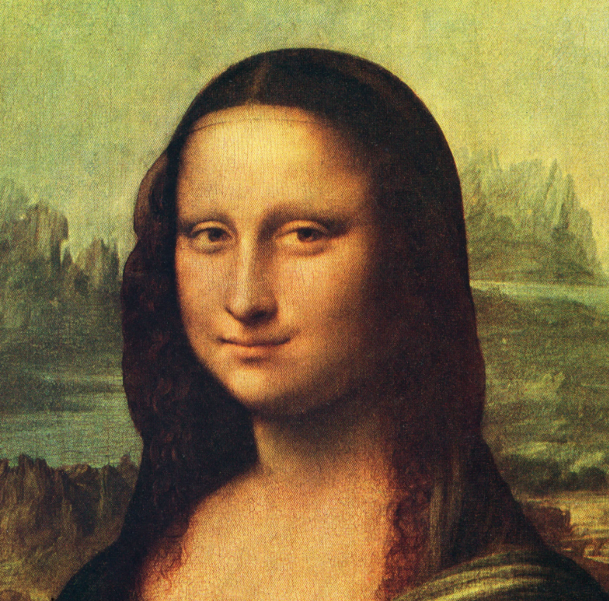
Goal
In this project, I attempt to use deep learning to identify human emotion based only on an image of an individual’s face. The resulting model will have uses in retail, customer service, and psychology!
Sad?
Happy?
Surprise?
Neutral?

Slide 3

Approach
To accomplish the goal, I will use transfer learning models - this will allow me to circumvent the need for a large data set and to minimize training time. To begin, I will test three popular transfer learning models:
VGG16: a 16-layer CNN introduced in 2013.
ResNet v2: a 467-layer CNN introduced in 2016.
Efficient Net: a 237-layer CNN introduced in 2019.

Slide 4


Architecture
Each model consist of the first 5 layers of the respective transfer learning model with 6 layers appended to them, namely a flatten layer, 4 dense layers, a dropout layer, and finally, a batch normalization layer.
VGG16
ResNet
Flatten
Dense (256)
Dense (128)
Dropout
Dense (64)
Dense (4)
Batch Normalization
Eff. Net

Slide 5
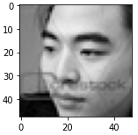
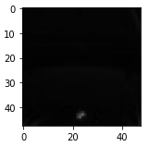
Data Set Limitations
Impurities
Some images in the data set do not show a face (as shown in the bottom right image). Furthermore, several images contain text (bottom left). When using transfer learning models, it is possible that the text on the images will severely affect the performances.
We should be cautious regarding the performance of the transfer learning models on the current data set, notably for the following two reasons.
Grayscale Dataset
One concern is that the data set is natively provided in grayscale. By stacking the grayscale images, I obtain RGB data which can be used by the models, however, this may negatively affect their performance.

Slide 6
Training Procedure
VGG 16 Trained for 20 epochs with a learning rate of 0.001 and a batch size of 32.
ResNet V2
Trained for 10 epochs with a learning rate of 0.001 and a batch size of 32.
Efficient Net
Trained for 10 epochs with a learning rate of 0.001 and a batch size of 32.

Slide 7
Performance Comparison
In the table below, I present the performances of the three transfer learning models as well as the custom-built CNN.
Model Name | Test Accuracy (%) | Test Loss
VGG16 | 52 | 1.11
ResNet v2 | 25 | 1.39
Efficient Net | 25 | 1.39
Note:
We observe that all three models showed relatively low performance on the test set. However, VGG16 achieves the highest performance with an accuracy of 52%.

Slide 8
Performance Insights
Since VGG16 performed the best, it is worthwhile to investigate other VGG models.
By evaluating the training metrics and validation metrics over training epochs, namely the accuracy and loss, it can be seen that as the number of epochs increases, the metrics improve. This suggests that overfitting is not occurring and that training for more epochs may be beneficial.
By varying the number of layers of the transfer learning model used, the performance may vary.
Thus, I will test VGG 16 and VGG 19, varying the layers used from each model and training for at least 20 epochs.

Slide 9
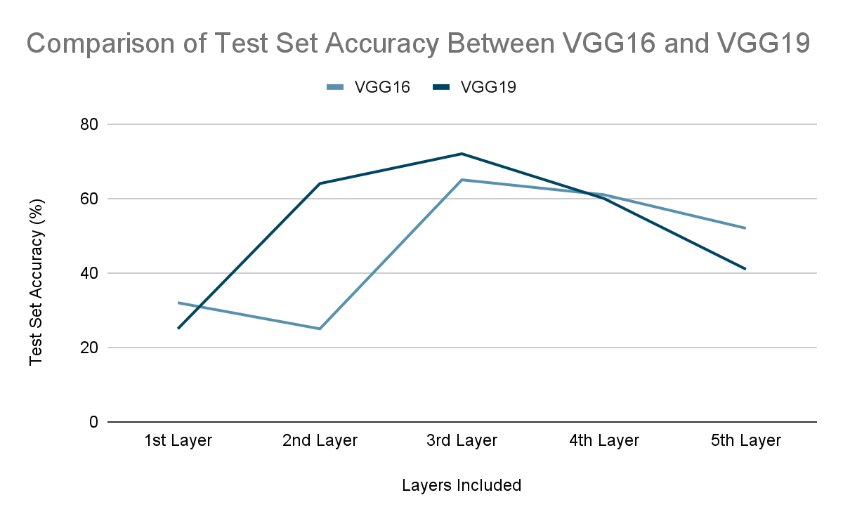
Visual Geometry Group (VGG) Comparisons
In the figure below, I present the performances of VGG 16 and VGG 19 over different number of layers included. Each training session went on for 25 epochs.
Note:
We observe that all both models peak when up-to their third layer is included. At that point, the VGG16 models obtains an test set accuracy of 65% and the VGG19 obtains a test set accuracy of 72%.

Slide 10
Key Outcomes
I conclude that when including the first 3 layers of VGG 19, we obtain a test set accuracy of 72% in only 25 epochs of training. For implementations that do not require high accuracy, this is an extremely efficient and widely applicable approach.

